Slide 1
R Fundamentals
Data Types and Basic Manipulation
http://bit.ly/2lcttua

Slide 2
What is R?
R is a open-source programming language and environment for statistical computing and graphics.
You can use R as it is, but most people prefer to use R in combination with the RStudio (GUI-based IDE for R), which has an organized layout and several extra options (RMarkdown, Shiny, etc).
To use R:
Install R https://www.r-project.org/
Install RStudio https://www.rstudio.com/

Slide 3
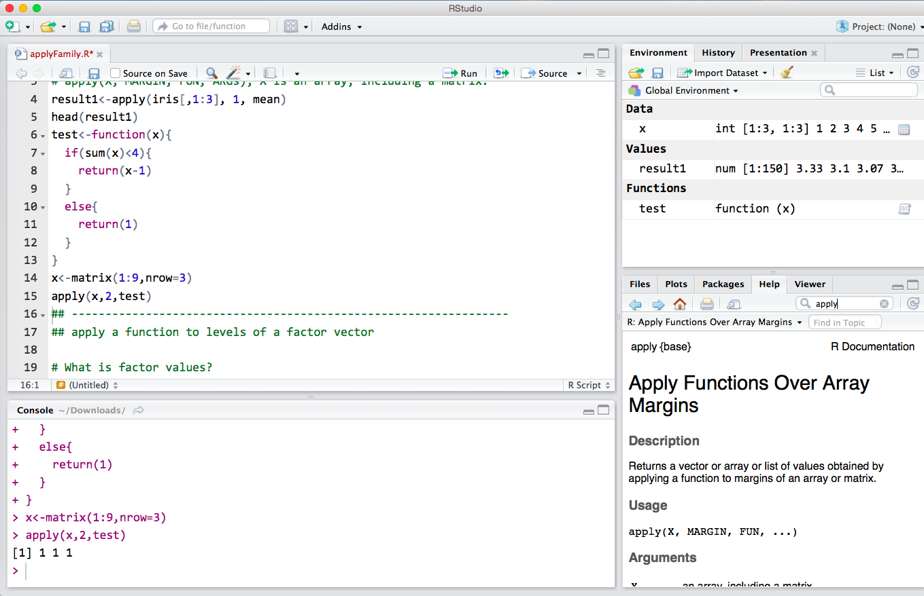
RStudio Interface
Console
Where commands are actually executed
“>” prompt
Script
Where commands are edited and saved
Click Run or press CTRL+ENTER(Windows)/command+return(MacOSX) to send it to the command window
Workspace/history window
Workspace shows data and values R has in its memory
The history window shows what has been typed before
Files / plots / packages
Where you can open files, view plots (also previous plots), install and load packages or use the help function

Slide 4
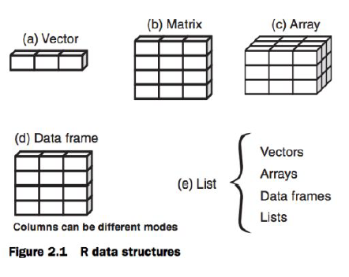
Basic R Concepts
Working Directory
Your working directory is the folder on your computer in which you are currently working
Open, save
getwd()
setwd(“"C:/Users/yj2360”) - forward slash
Fundamental Data Objects
vector(): 1-D data; all elements of the same type
matrix(): 2-D data, all values of the same type
array(): multi-D data, all values of the same type
list(): one-D data, elements of different modes
data.frame(): 2-D data, elements of different types
Factor values
A factor is a character vector with information about the possible categories, called the levels of the factor

Slide 5
Matrix and Data Frame
m<-matrix(1:4,nrow=2,ncol=2)
m
dim(m)
x<-1:3
y<-10:12
cbind(x,y)
rbind(x,y)
dat<-data.frame(id=letter[1:5], x=1:10, y=11:20)
t = data.frame(x = c(11,12,14), 2 y = c(19,20,21), z = c(10,9,7))
t
mean(t$z)
# commonly used data frame functions:
head(); dim(); nrow(); ncol(); str(); names()

Slide 6
Basic R Operations
Creation and assignment
Use <- to create an object and assign values to it
Commenting
Anything after # will not be evaluated/executed
Used to leave notes for others reading your code
Importing data
Read in different forms of data
Filtering data
Logical and relational operators: ! & | == != >= <=
Plotting Data
Use plot() function to plot data

Slide 7
Looping
Looping is equivalent to iterating or just replicating instructions. Let the computer take over the repetitive work and you will find your life becomes much easier.
For Loop
for(variable in sequence) {
statements
}
> data <- rep(2,10)
> for(i in 1:10)
{
data[i] <- i^2
if(data[i]==3) {next}
data[i]
}
While Loop
while(condition) {statements}
> a<-NULL
> i=1
> while (length(a)<10) {
a[i]<-i
i=i+1
}

Slide 8
Writing Functions
A function is a machine which turns input objects (arguments) into an output object (return value), according to some algorithm.
myfct <- function(arg1, arg2, ...) {
function_body
}
> fun1 <- function(arg1, arg2 )
{
w = arg1 ^ 2
return(arg2 + w)
}
> fun1(arg1 = 3, arg2 = 5)
14

Slide 9
Using Packages
Applications of R normally use a package; i.e., a library of special functions designed for a specific problem.
install.packages("<the package's name>")
library("<the package's name>")
Most commonly used packages are
Data processing: dplyr, tidyr, reshape2, XLConnect
Plotting: gglot2, htmlwidgets, rgl
Data modeling: car, forecast, glmnet, zoo, randomForest, caret
Other: knitr, RColorBrewer, ggmap, shiny

Slide 10
More resources
Help function
Use ?<function name> if you know the exact function name
Use ??<function name> to do a fuzzy search
Swirl package
An interactive learning package for first-time R users
RStudio’s Cheatsheets
Books
R for Data Science
R Cookbook
R for Statistical Analysis
Online courses

